Slide 1
Build tool- Maven
Unit IV

Slide 2
Maven
Maven is a powerful project management tool that is based on POM (project object model). It is used for projects build, dependency and documentation.
The set of plugins are shared by all projects using Maven, providing a uniform build system.

Slide 3
What it does?
It does mainly following tasks.
It makes a project easy to build
It provides uniform build process (maven project can be shared by all the maven projects)
It provides project information (log document, cross referenced sources, mailing list, dependency list, unit test reports etc.)
It is easy to migrate for new features of Maven

Slide 4
Apache Maven helps to manage
Builds
Documentation
Reporting
SCMs
Releases
Distribution

Slide 5
What is Build Tool
A build tool takes care of everything for building a process. It does following:
Generates source code (if auto-generated code is used)
Generates documentation from source code
Compiles source code
Packages compiled code into JAR of ZIP file
Installs the packaged code in local repository, server repository, or central repository

Slide 6
How to install Maven on windows
You can download and install maven on windows, linux and MAC OS platforms. Here, we are going how to install maven on windows OS.
To install maven on windows, you need to perform following steps:
Download maven and extract it
Add JAVA_HOME and MAVEN_HOME in environment variable
Add maven path in environment variable
Verify Maven

Slide 7
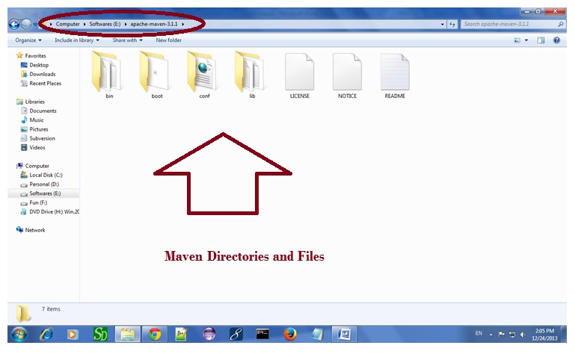
1. Download Maven
Maven is a Java based tool, so the very first requirement is to have JDK installed on your machine.
To install maven on windows, you need to download apache maven first.
Download Maven latest Maven software from Download latest version of Maven
For example: apache-maven-3.1.1-bin.zip
Extract it.

Slide 8
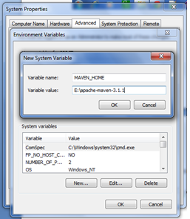
2. Add MAVEN_HOME in environment variable
Right click on MyComputer -> properties -> Advanced System Settings -> Environment variables -> click new button
Now add MAVEN_HOME in variable name and path of maven in variable value. It must be the home directory of maven i.e. outer directory of bin. For example: E:\apache-maven-3.1.1 .It is displayed below:
Now Click ok button

Slide 9
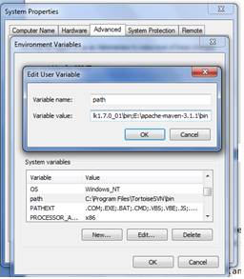
3. Add Maven Path in environment variable
Here, we have installed JDK and its path is set by default, so we are going to append the path of maven.
The path of maven should be %maven home%/bin.
For example, E:\apache-maven-3.1.1\bin .

Slide 10
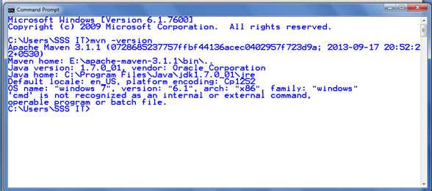
4)Verify maven
To verify whether maven is installed or not, open the command prompt and write:
mvn −version

Slide 11
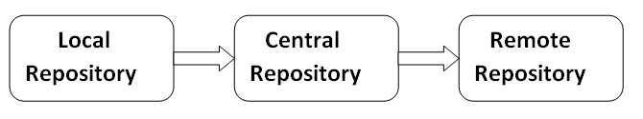
Maven Repository
A maven repository is a directory of packaged JAR file with pom.xml file.
There are 3 types of maven repository:
Local Repository
Central Repository
Remote Repository
Maven searches for dependencies in the repositories the following order
Local repository then Central repository then Remote repository.

Slide 12
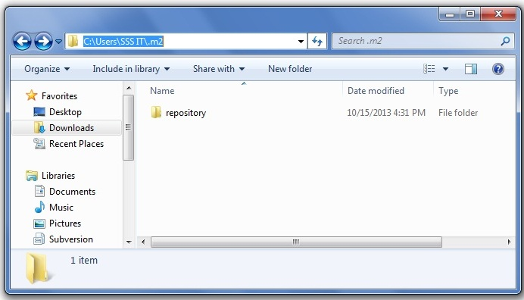
1. Maven Local Repository
Maven local repository is located in your local system. It is created by the maven when you run any maven command.
By default, maven local repository is %USER_HOME%/.m2 directory. For example: C:\Users\SSS IT\.m2.

Slide 13
Update location of Local Repository
We can change the location of maven local repository by changing the settings.xml file. It is located in MAVEN_HOME/conf/settings.xml, for example: E:\apache-maven-3.1.1\conf\settings.xml.
Let's see the default code of settings.xml file.

Slide 14
Before settings.xml
<settings xmlns="http://maven.apache.org/SETTINGS/1.0.0"
xmlns:xsi="http://www.w3.org/2001/XMLSchema-instance"
xsi:schemaLocation="http://maven.apache.org/SETTINGS/1.0.0 http://maven.apache.org/xsd/settings-1.0.0.xsd">
<!-- localRepository
| The path to the local repository maven will use to store artifacts.
|
| Default: ${user.home}/.m2/repository
<localRepository>/path/to/local/repo</localRepository>
-->
</settings>

Slide 15
After settings.xml
<settings xmlns="http://maven.apache.org/SETTINGS/1.0.0"
xmlns:xsi="http://www.w3.org/2001/XMLSchema-instance"
xsi:schemaLocation="http://maven.apache.org/SETTINGS/1.0.0 http://maven.apache.org/xsd/settings-1.0.0.xsd">
<localRepository>e:/mavenlocalrepository</localRepository>
</settings>

Slide 16
2. Maven Central Repository
Maven central repository is located on the web. It has been created by the apache maven community itself.
The path of central repository is: http://repo1.maven.org/maven2/.
The central repository contains a lot of common libraries that can be viewed by this URL http://search.maven.org/#browse.

Slide 17
3. Maven Remote Repository
Maven remote repository is located on the web. Most of libraries can be missing from the central repository such as JBoss library etc, so we need to define remote repository in pom.xml file.

Slide 18
Maven Example
We can create a simple maven example by executing the archetype:generate command of mvn tool.
To create a simple java project using maven, you need to open command prompt and run the archetype:generate command of mvn tool.
Archetype is a Maven project templating toolkit
To create a new project based on an Archetype, need to call mvn archetype:generate
Syntax
The syntax to generate the project architecture is given below:
mvn archetype:generate -DgroupId=groupid -DartifactId=artifactid -DarchetypeArtifactId=maven-archetype-quickstart - DinteractiveMode=booleanValue

Slide 19
Maven Example
Example
The example to generate the project architecture is given below:
mvn archetype:generate -DgroupId=com.javatpoint -DartifactId=CubeGenerator -DarchetypeArtifactId=maven-archetype-quickstart -DinteractiveMode=false

Slide 20
Archetype artifacts
Archetype ArtifactIds | Description
maven-archetype-archetype | An archetype to generate a sample archetype project.
maven-archetype-j2ee-simple | An archetype to generate a simplifed sample J2EE application.
maven-archetype-plugin | An archetype to generate a sample Maven plugin.
maven-archetype-plugin-site | An archetype to generate a sample Maven plugin site.
maven-archetype-portlet | An archetype to generate a sample JSR-268 Portlet.
maven-archetype-quickstart | An archetype to generate a sample Maven project.
maven-archetype-simple | An archetype to generate a simple Maven project.
maven-archetype-site-simple | An archetype to generate a sample Maven site.
maven-archetype-webapp | An archetype to generate a sample Maven Webapp project.

Slide 21
Compile the Maven Java Project
To compile the project, go to the project directory,
for example: C:\Users\SSS IT\CubeGenerator and write the following command on the command prompt:
mvn clean compile

Slide 22
Run the Maven Java Project
o run the project, go to the project directory\target\classes,
for example: C:\Users\SSS IT\CubeGenerator\target\classes and write the following command on the command prompt:
java com.javatpoint.App

Slide 23
Maven pom.xml file
POM is an acronym for Project Object Model. The pom.xml file contains information of project and configuration information for the maven to build the project such as dependencies, build directory, source directory, test source directory, plugin, goals etc.

Slide 24
Maven Overview - Core Concepts
Maven is centered around the concept of POM files (Project Object Model).
A POM file is an XML representation of project resources like source code, test code, dependencies (external JARs used) etc.
The POM contains references to all of these resources. The POM file should be located in the root directory of the project

Slide 25
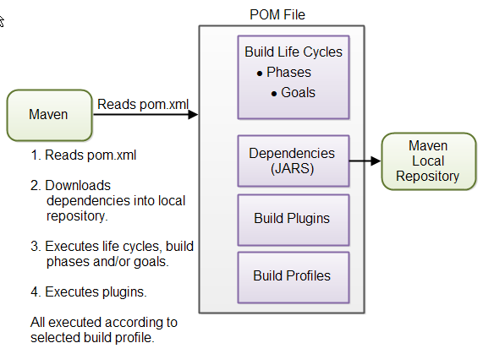
diagram illustrating how Maven uses the POM file, and what the POM file primarily contains:

Slide 26
Build Life Cycles, Phases and Goals
The build process in Maven is split up into
build life cycles,
phases and
goals.
A build life cycle consists of a sequence of build phases, and each build phase consists of a sequence of goals.
When you run Maven you pass a command to Maven. This command is the name of a build life cycle, phase or goal. If a life cycle is requested executed, all build phases in that life cycle are executed.
If a build phase is requested executed, all build phases before it in the pre-defined sequence of build phases are executed too.

Slide 27
Dependencies and Repositories
One of the first goals Maven executes is to check the dependencies needed by your project.
Dependencies are external JAR files (Java libraries) that your project uses.
If the dependencies are not found in the local Maven repository, Maven downloads them from a central Maven repository and puts them in your local repository.
The local repository is just a directory on your computer's hard disk. You can specify where the local repository should be located if you want to (I do). You can also specify which remote repository to use for downloading dependencies.

Slide 28
Build Plugins
Build plugins are used to insert extra goals into a build phase.
If you need to perform a set of actions for your project which are not covered by the standard Maven build phases and goals, you can add a plugin to the POM file.
Maven has some standard plugins you can use, and you can also implement your own in Java if you need to.

Slide 29
Build Profiles
Build profiles are used if you need to build your project in different ways.
For instance, you may need to build your project for your local computer, for development and test. And you may need to build it for deployment on your production environment.
These two builds may be different. To enable different builds you can add different build profiles to your POM files. When executing Maven you can tell which build profile to use.

Slide 30
Elements of maven pom.xml file
Element | Description
project | It is the root element of pom.xml file.
modelVersion | It is the sub element of project. It specifies the modelVersion. It should be set to 4.0.0.
groupId | It is the sub element of project. It specifies the id for the project group.
artifactId | It is the sub element of project. It specifies the id for the artifact (project). An artifact is something that is either produced or used by a project. Examples of artifacts produced by Maven for a project include: JARs, source and binary distributions, and WARs.
version | It is the sub element of project. It specifies the version of the artifact under given group.

Slide 31
File: pom.xml
<project xmlns="http://maven.apache.org/POM/4.0.0"
xmlns:xsi="http://www.w3.org/2001/XMLSchema-instance"
xsi:schemaLocation="http://maven.apache.org/POM/4.0.0
http://maven.apache.org/xsd/maven-4.0.0.xsd">
<modelVersion>4.0.0</modelVersion>
<groupId>com.javatpoint.application1</groupId>
<artifactId>my-app</artifactId>
<version>1</version>
</project>

Slide 32
Maven pom.xml file with additional elements
Element | Description
packaging | defines packaging type such as jar, war etc.
name | defines name of the maven project.
url | defines url of the project.
dependencies | defines dependencies for this project.
dependency | defines a dependency. It is used inside dependencies.
scope | defines scope for this maven project. It can be compile, provided, runtime, test and system.

Slide 33
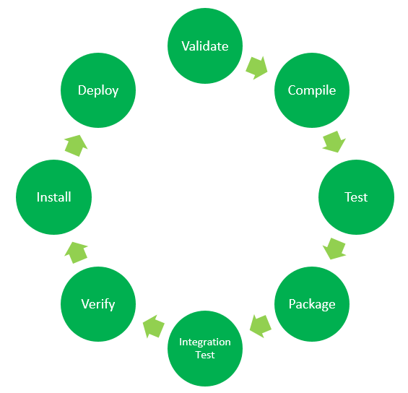
Maven Lifecycle:
Maven lifecycle and its 8 steps: Validate, Compile, Test, Package, Integration test, Verify, Install and Deploy

Slide 34
Maven Lifecycle
The default Maven lifecycle consists of 8 major steps or phases for compiling, testing, building and installing a given Java project as specified below:
Validate: This step validates if the project structure is correct. For example – It checks if all the dependencies have been downloaded and are available in the local repository.
Compile: It compiles the source code, converts the .java files to .class and stores the classes in target/classes folder.
Test: It runs unit tests for the project.
Package: This step packages the compiled code in distributable format like JAR or WAR.
Integration test: It runs the integration tests for the project.
Verify: This step runs checks to verify that the project is valid and meets the quality standards.
Install: This step installs the packaged code to the local Maven repository.
Deploy: It copies the packaged code to the remote repository for sharing it with other developers.

Slide 35
Default (or Build) Lifecycle
This is the primary life cycle of Maven and is used to build the application. It has the following 21 phases.
Sr.No. | Lifecycle Phase & Description
1 | validate Validates whether project is correct and all necessary information is available to complete the build process.
2 | initialize Initializes build state, for example set properties.
3 | generate-sources Generate any source code to be included in compilation phase.
4 | process-sources Process the source code, for example, filter any value.
5 | generate-resources Generate resources to be included in the package.

Slide 36
Default (or Build) Lifecycle
6 | process-resources Copy and process the resources into the destination directory, ready for packaging phase.
7 | compile Compile the source code of the project.
8 | process-classes Post-process the generated files from compilation, for example to do bytecode enhancement/optimization on Java classes.
9 | generate-test-sources Generate any test source code to be included in compilation phase.
10 | process-test-sources Process the test source code, for example, filter any values.
11 | test-compile Compile the test source code into the test destination directory.
12 | process-test-classes Process the generated files from test code file compilation.

Slide 37
Default (or Build) Lifecycle
13 | test Run tests using a suitable unit testing framework (Junit is one).
14 | prepare-package Perform any operations necessary to prepare a package before the actual packaging.
15 | package Take the compiled code and package it in its distributable format, such as a JAR, WAR, or EAR file.
16 | pre-integration-test Perform actions required before integration tests are executed. For example, setting up the required environment.
17 | integration-test Process and deploy the package if necessary into an environment where integration tests can be run.
18 | post-integration-test Perform actions required after integration tests have been executed. For example, cleaning up the environment.
19 | verify Run any check-ups to verify the package is valid and meets quality criteria.

Slide 38
Default (or Build) Lifecycle
20 | install Install the package into the local repository, which can be used as a dependency in other projects locally.
21 | deploy Copies the final package to the remote repository for sharing with other developers and projects.

Slide 39
Maven Commands:
mvn clean: Cleans the project and removes all files generated by the previous build.
mvn compile: Compiles source code of the project.
mvn test-compile: Compiles the test source code.
mvn test: Runs tests for the project.
mvn package: Creates JAR or WAR file for the project to convert it into a distributable format.
mvn install: Deploys the packaged JAR/ WAR file to the local repository.
mvn deploy: Copies the packaged JAR/ WAR file to the remote repository after compiling, running tests and building the project.

Slide 40
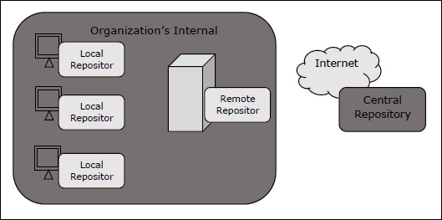
What is a Maven Repository?
In Maven terminology, a repository is a directory where all the project jars, library jar, plugins or any other project specific artifacts are stored and can be used by Maven easily.
Maven repository are of three types. The following illustration will give an idea regarding these three types.
local
central
remote

Slide 41
Local Repository
Maven local repository is a folder location on your machine. It gets created when you run any maven command for the first time.
Maven local repository keeps your project's all dependencies (library jars, plugin jars etc.). When you run a Maven build, then Maven automatically downloads all the dependency jars into the local repository. It helps to avoid references to dependencies stored on remote machine every time a project is build.
Maven local repository by default get created by Maven in %USER_HOME% directory. To override the default location, mention another path in Maven settings.xml file available at %M2_HOME%\conf directory.

Slide 42
Central Repository
Maven central repository is repository provided by Maven community. It contains a large number of commonly used libraries.
When Maven does not find any dependency in local repository, it starts searching in central repository using following URL − https://repo1.maven.org/maven2/
Key concepts of Central repository are as follows −
This repository is managed by Maven community.
It is not required to be configured.
It requires internet access to be searched.
To browse the content of central maven repository, maven community has provided a URL − https://search.maven.org/#browse. Using this library, a developer can search all the available libraries in central repository.

Slide 43
Remote Repository
Sometimes, Maven does not find a mentioned dependency in central repository as well. It then stops the build process and output error message to console. To prevent such situation, Maven provides concept of Remote Repository, which is developer's own custom repository containing required libraries or other project jars.
For example, using below mentioned POM.xml, Maven will download dependency (not available in central repository) from Remote Repositories mentioned in the same pom.xml.

Slide 44
Maven Dependency Search Sequence
When we execute Maven build commands, Maven starts looking for dependency libraries in the following sequence −
Step 1 − Search dependency in local repository, if not found, move to step 2 else perform the further processing.
Step 2 − Search dependency in central repository, if not found and remote repository/repositories is/are mentioned then move to step 4. Else it is downloaded to local repository for future reference.
Step 3 − If a remote repository has not been mentioned, Maven simply stops the processing and throws error (Unable to find dependency).
Step 4 − Search dependency in remote repository or repositories, if found then it is downloaded to local repository for future reference. Otherwise, Maven stops processing and throws error (Unable to find dependency).

Slide 45
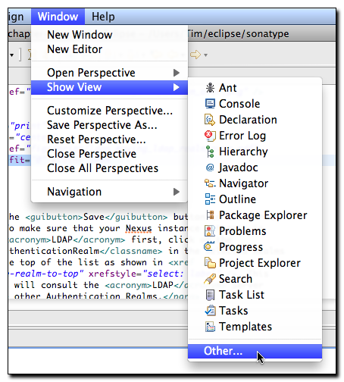
Opening the Maven Repository View
To browse Maven repositories and to manipulate repository indexes open the Maven Repositories view by selecting Windows, Show View,

Slide 46
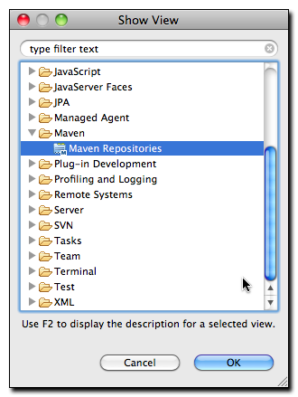
Once you select Other... Eclipse will display a dialog containing all available views. Select the Maven Repositories view under the Maven folder in the Show View dialog as shown in Figure, “Selecting the Maven Repositories View in the Show View Dialog”.

Slide 47
Once you have selected Maven Repositories and clicked on the OK button, Eclipse will then load the Maven Repositories view. This view contains three folders:
Local Repositories
This folder contains your local Maven repository which is stored in ~/.m2/repository by default. It also contains a repository that represents the Maven projects contained in your Eclipse workspace.
Global Repositories
This folder contains any global Maven repositories that are referenced by all Maven projects. This folder contains the Central Maven repository under the repository identifier of "central". It will also contain mirrors that have been configured in your Maven Settings (~/.m2/settings.xml).
Project Repositories
This folder contains repositories which are defined by your projects. These repositories are present either in your project's pom.xml file or in an active Maven Profile.

Slide 48
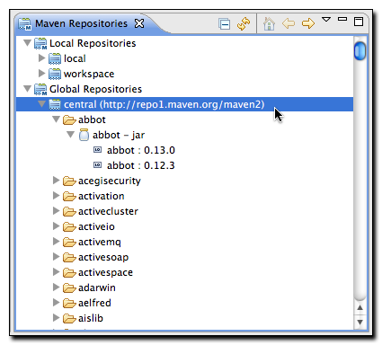
Browsing Global Repositories
This is default repository from which Maven will retrieve dependencies and other artifacts needed during a build. If you expand the central repository, you will be able to browse the contents of the repository and double click on specific artifacts. Double-clicking on one of the artifacts shown in Figure , “Browsing a Global Repository” will load that artifact's POM in the Form-based POM Editor.

Slide 49
Maven - Snapshots
A large software application generally consists of multiple modules and it is common scenario where multiple teams are working on different modules of same application.
For example, consider a team is working on the front end of the application as app-ui project (app-ui.jar:1.0) and they are using data-service project (data-service.jar:1.0).
Now it may happen that team working on data-service is undergoing bug fixing or enhancements at rapid pace and they are releasing the library to remote repository almost every other day.

Slide 50
Maven - Snapshots
if data-service team uploads a new version every other day, then following problems will arise −
data-service team should tell app-ui team every time when they have released an updated code.
app-ui team required to update their pom.xml regularly to get the updated version.
To handle such kind of situation, SNAPSHOT concept

Slide 51
What is SNAPSHOT?
SNAPSHOT is a special version that indicates a current development copy. Unlike regular versions, Maven checks for a new SNAPSHOT version in a remote repository for every build.
Now data-service team will release SNAPSHOT of its updated code every time to repository, say data-service: 1.0-SNAPSHOT, replacing an older SNAPSHOT jar.

Slide 52
Snapshot vs Version
In case of Version, if Maven once downloaded the mentioned version, say data-service:1.0, it will never try to download a newer 1.0 available in repository. To download the updated code, data-service version is be upgraded to 1.1.
In case of SNAPSHOT, Maven will automatically fetch the latest SNAPSHOT (data-service:1.0-SNAPSHOT) every time app-ui team build their project.

Slide 53
Maven - Plugins
What are Maven Plugins?
Maven is actually a plugin execution framework where every task is actually done by plugins. Maven Plugins are generally used to −
create jar file
create war file
compile code files
unit testing of code
create project documentation
create project reports

Slide 54
Plugin Types
Sr.No. | Type & Description
1 | Build plugins They execute during the build process and should be configured in the <build/> element of pom.xml.
2 | Reporting plugins They execute during the site generation process and they should be configured in the <reporting/> element of the pom.xml.

Slide 55
list of few common plugins
Sr.No. | Plugin & Description
1 | clean Cleans up target after the build. Deletes the target directory.
2 | compiler Compiles Java source files.
3 | surefire Runs the JUnit unit tests. Creates test reports.
4 | jar Builds a JAR file from the current project.
5 | war Builds a WAR file from the current project.
6 | javadoc Generates Javadoc for the project.
7 | antrun Runs a set of ant tasks from any phase mentioned of the build.

